Slide 1


Microsoft Device Partner Sales (DPS)

Slide 2
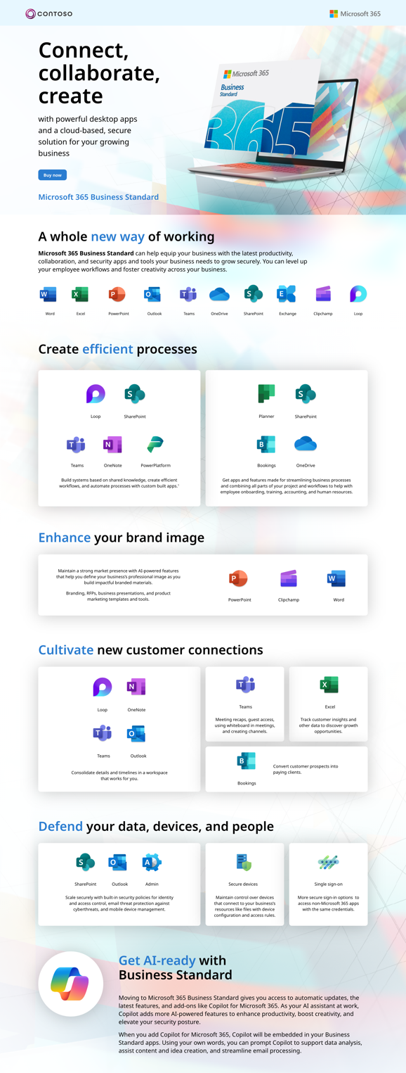

DPS – Campaign Partner Assets
Engagement Overview
Affirma was asked to develop and design global marketing campaign assets for the Microsoft Device Partners Sales Category team. These assets are to be leveraged for Microsoft and Distributers to reconnect with new and dormant enterprise resellers.
Supported categories
Education
M365
Teams Rooms
Windows Pro
Windows Server
1000+ Assets created
Ambient animations
Email Templates
PPT templates
Website layout designs
Social media visuals
Teams backgrounds
Static banners
For Microsoft internal use only

Slide 3

Device Partner Sales Campaign Assets
Client Need
Microsoft’s Device Partner Sales (DPS) team needed two full campaign kits for their global partners to utilize in their FY24/25 sales efforts. This included messaging creation based on research, creative consultation, and the creation of over 50 assets across both campaigns.
Workstreams & Outcomes
In response, Affirma delivered:​
Messaging and Positioning Framework (MPF)
Bill of materials (BOMs) covering the entire customer journey
Campaign 1:
Net new MPF, 4 static banner ads, 4 animated banner ads, 10 social ads, 2 landing pages, 11 email templates, 1 one-pager, 2 infographics, 1 20-page e-book, large-scale campaign image, 2 animated videos, a master copy document, and an execution guide for partners.
Campaign 2:
Editing existing MPF, 4 static banner ads, 4 animated banner ads, 6 email templates, 2 landing pages, 1 A+ content/enhanced content for a product detail page, 4 social posts, 2 one-pagers, a master copy document, and an execution guide for partners.
Video add-on
3 60-second animated videos
For Microsoft internal use only

